Slide 1
Designing & Implementing
Data Pipelines for
Scientific Research
Lecture 1:
Introduction to Datapipelines

Slide 2
About me
I come from a physics background, focusing on neuromorphic computing and reservoir computing (RC).
My interests are the intersection of condensed matter physics, complex and dynamical systems, computational neuroscience, graph theory, and machine learning.
I too have been plagued with atrocious pipelines!
Notes:
I am the machine learning engineer for the Accelerate Science Programme. So I come from a primarily physics background. I did my undergrad and grad studies at the University of Canterbury in New Zealand. And my research focused on neuromorphic computing, which is trying to make computers that work like a brain. You often get this comparison with neural networks in deep learning of being similar to biological neurons, when in fact they really aren’t similar at all. But there are groups out there that are trying to exploit what knowledge we have of the brain’s topology to try and build machines that mimic the function and performance of the brain. A common device is the memristor, or the resistive switch, which is sort of like a resistor with memory of previous input. And it’s surprising how far you can get with just slapping a bunch of tin clusters onto a substrate and dumping some current into it.
So this means that my interests spanned a pretty wide range, but a common thread amongst them was machine learning, because ultimately we’re interested in building machines that can learn. Our work involved simulations, massive amounts of data, then machine learning algorithms, and then finally inference and visualization.
Of course I’ve been in the position where things have just been moving too quickly. As academics, PhD students and early post-docs, I know that you’re probably under a lot pressure to produce results, and you end up with this feeling of trying to outrun yourself. You have on the surface, some results, which are certainly thorough and you’ve hard to get them, but underneath the surface is just a litany of untitled Jupyter notebooks, random matlab files, just chaos. And I always found that hard to get on top of. How can you stop and make everything neat and tidy and presentable, when you have a grant application due in two days, or a deadline to ICML next week, or thegeneral disappointment of your PI hanging over you.

Slide 3
About the course
The goal of this course is to move through the exploratory analysis phase, and into the automation phase.
Designing data pipelines for scientific research, can be challenging.
It is often unique to each requirement, but there are some good software engineering methodologies that we can enforce.
Like anything, it’s a craft that needs to be practiced.
Notes:
So that’s basically the goal of this course: to take you from the exploratory phase, the reliance on Jupyter notebooks, and into the automation phase – where we have efficient pipelines that can handle all of our data.
We aim for transparency and reproducibility as a key goal. When you make everything public, there’s nowhere to hide. We want to publish any and all code that was used to produce results.

Slide 4
About the course
The course is split into three lectures and three corresponding labs:
Exploratory analysis and data transformations
Scripting
Testing
Ad stuff about differences
Notes:
So what exactly are we going to do?
The course is split into lectures and labs. There are a total of 3 labs for you to work through:
Exploratory analysis and transformations
Scripting
Testing

Slide 5
What is a data pipeline?
Industry
No real standard definition
Data science
The part of your code that does all of your data preprocessing (such as cleaning and feature engineering.
The pipeline is not really an independent entity, but it is closely aligned with the model
Our “definition”
A data pipeline is a software artefact that consists of all the steps related to preparing data for a scientific study, it is published with its accompanying testing framework, documentation and can easily be installed, forked, extended and deployed.
Notes:
The thing about data pipelines is that they can become independent artefacts themselves, rather than just as a means to an end. And I’m going to show you an example in a second, but an analogy might be with lecture notes vs a text book.

Slide 6



Pipelines in programming
Data pipelines can take different forms depending on the language, models, or libraries that you’re using.
Notes:
Data pipelines can be highly language, and even model dependent, and we’re going to explore some off the shelf solutions from two python libraries: PyTorch, and Scikit-Learn. So sklearn and PyTorch have the Pipeline, and Compose objects that we’re going to explore.
Then we’re also going to look at well what if my stuff doesn’t fit neatly into these packages.
I should stress again that this is a python focused course. I don’t want any R peasants. Actually R was invented by two New Zealand researchers at the University of Auckland. So…you’re welcome.

Slide 7
The pipeline as an artefact
Think of lecture notes as an analogy.
In the first instance the notes are implemented by the lecturer in a very ad hoc way - sometimes even hand written and then copied on the board for the class. Eventually a student volunteers to latex (scribe) them.
The latexed version of the notes help the lecturer make the notes more and more elaborate and polished with each passing year.
As the lecturer gets more feedback (and time!) they start to fix typos, insert more explanations and add more examples/exercises.
Eventually the quality of the notes become so high that they start to get circulated in the community and other lecturers adopt them for their own teaching. In particular, ex-students of the lecturer start to use them in their teaching and possibly even enhance them.
Notes:
The pipeline is dependent on the model. And this makes sense, you might alter your pipeline depending on what model you use.

Slide 8
The pipeline as an artefact
To become a textbook the lecturer must restructure the notes into chapters with minimal dependency between them to allow different pathways through the textbook.
An index is added to make the book useful as a reference for researchers, and solutions are added to make it useful for self-study.
There is considerable effort involved into turning the notes into a textbook even though that effort doesn’t substantially increase the core technical content of the original notes.
However, the changes enable the content to be far more reusable to a much wider and diverse audience.
Pipelines as artefacts are the equivalent of turning the messy ad-hoc code that you implemented for your very specific research objectives into something that can be adopted by a much broader audience, in the same way that textbooks undergo a journey from lecture notes to published book.
Notes:
The pipeline is dependent on the model. And this makes sense, you might alter your pipeline depending on what model you use.

Slide 9
Why should you care?
Well-documented pipelines can make the peer-review process easier and more transparent.
Shareable pipelines make it easier for other scientists to use the pipeline and reproduce results
Easier to build on your work (or for other people to build on your work)
Some data pipelines can be highly impactful
Example: Netts
Notes:
So that’s basically the goal of this course: to take you from the exploratory phase, the reliance on Jupyter notebooks, and into the automation phase – where we have efficient pipelines that can handle all of our data.
We aim for transparency and reproducibility as a key goal. When you make everything public, there’s nowhere to hide. We want to publish any and all code that was used to produce results.

Slide 10
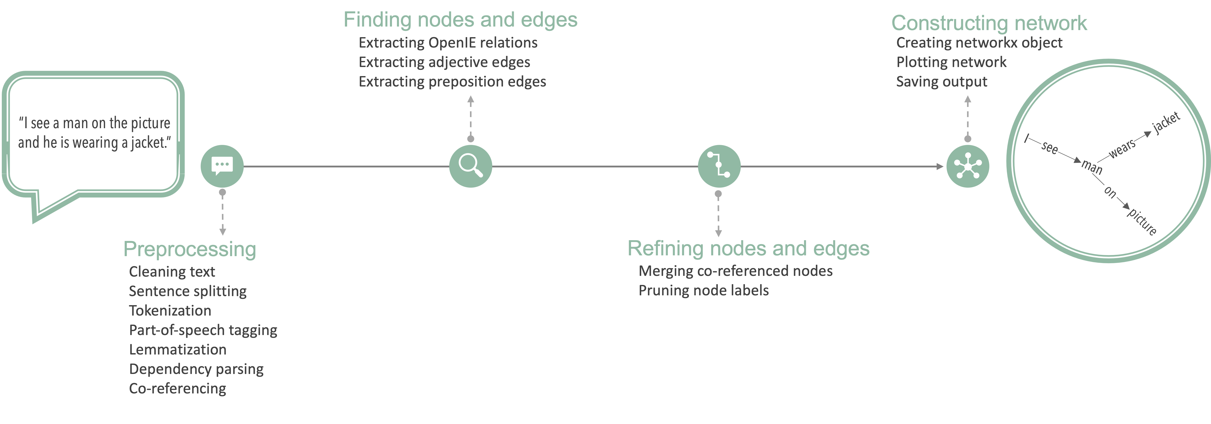
NETworks of Transcript Semantics: NETTS
Notes:
So that’s basically the goal of this course: to take you from the exploratory phase, the reliance on Jupyter notebooks, and into the automation phase – where we have efficient pipelines that can handle all of our data.
We aim for transparency and reproducibility as a key goal. When you make everything public, there’s nowhere to hide. We want to publish any and all code that was used to produce results.

Slide 11
The scikit-learn pipeline
The pipeline object in scikit-learn is designed to meet the aforementioned desirable properties of pipelines, so it's a good idea to use it when implementing pipelines in python.
Even if you don’t use it, it’s useful to study it and use it as a template when implementing your own pipeline from scratch (or in another language).
A pipeline object in scikit is simply a chain of scikit transformer objects, so let’s define what those are first.
Notes:
The pipeline is dependent on the model. And this makes sense, you might alter your pipeline depending on what model you use.

Slide 12
Transformations in scikit-learn
Transformer objects in scikit are simply objects that transform an input X in some way.
They have three main callable methods:
fit(X, y)
transform(X)
fit_transform(X, y)
Youfirst “calibrate” it with some values according a training dataset using fit, then use the calibrated version to transform another dataset using transform. The fit_transform method, fits and then transforms the data in one call.
Let’s look at an example of a transformation.
Notes:
Question: if there is this

Slide 13
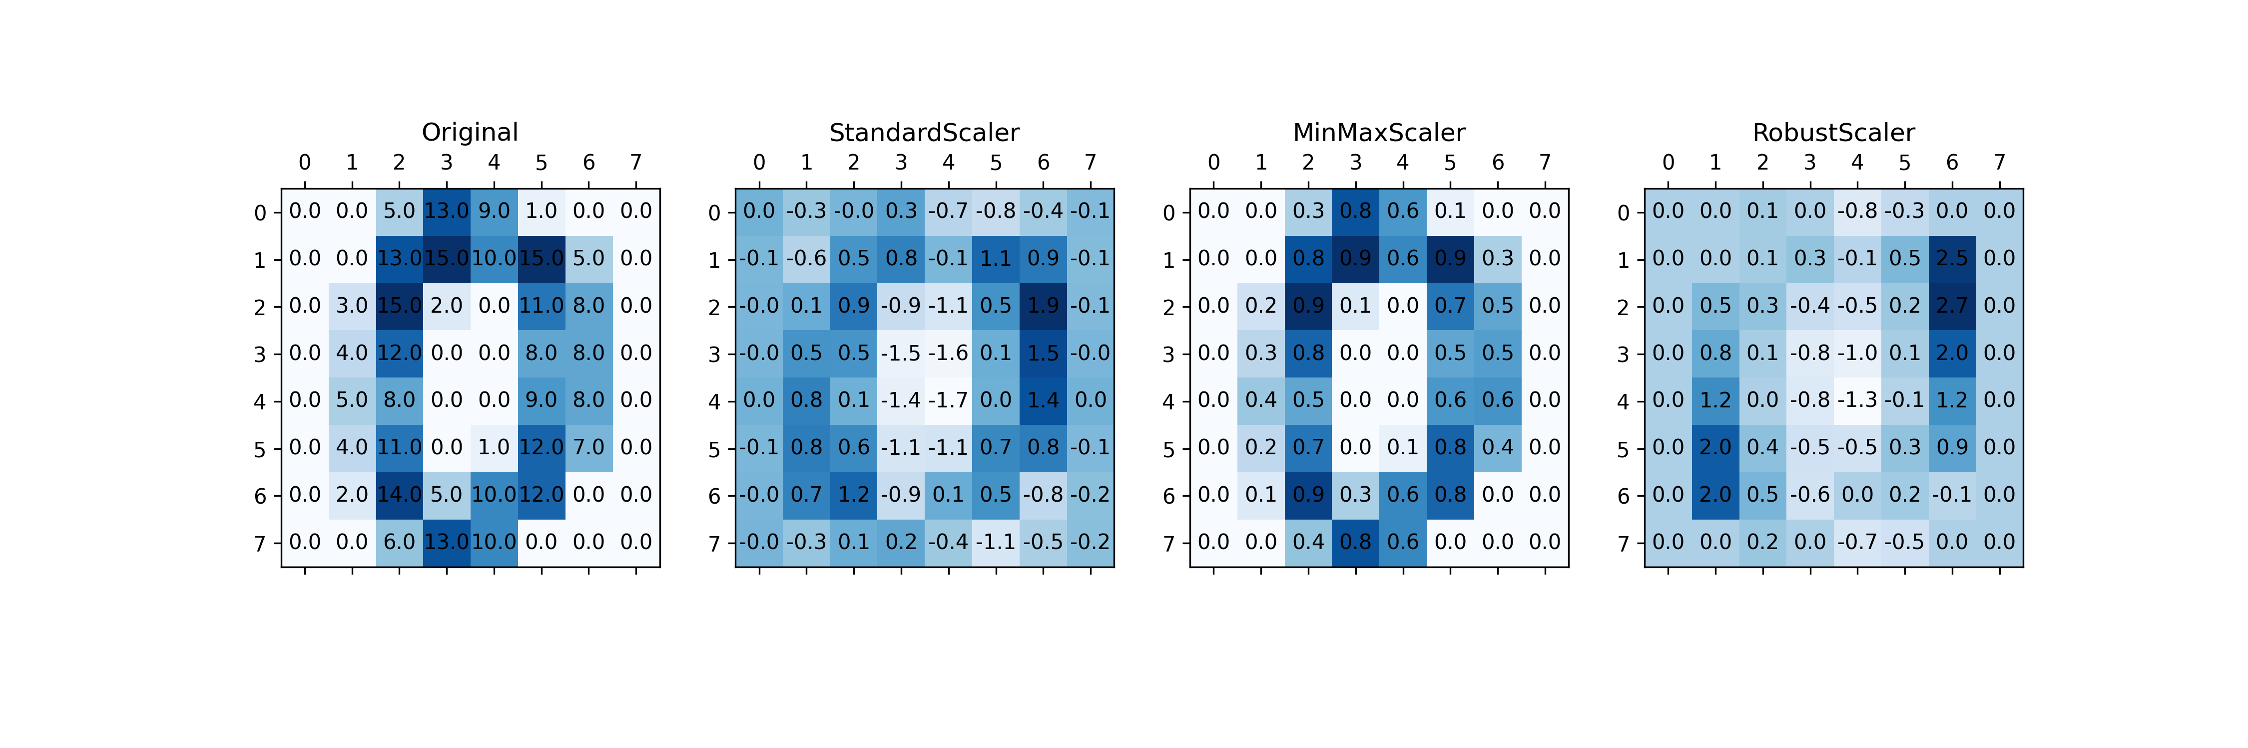
Transformations in scikit-learn
Notes:
This is a method of scaling

Slide 14
Transformations in scikit-learn
This is just one type of transformation, but scikit-learn comes bundled with a bunch of different transformations
The cool thing is that you can also create custom transformations using scikit-learn’s BaseEstimator (which we will see later in one of the labs).
You can define your own fit() and transform() methods.
This means that other people can use only the transformer that you implemented, even if they don’t care about the rest of your pipeline.
There is a well-established scikit-learn ecosystem of custom transformers out there, so it is possible that if you don’t know how to implement it yourself, somebody has already done it!
Notes:
Question: if there is this

Slide 15
Transformations in PyTorch
Transforming your data in PyTorch is done using the the transforms module from torchvision and torchaudio.
Just like sklearn, they offer some prepackaged transformations:
GaussianBlur
Normalize
RandomVerticalFlip
MelSpectrogram
Just like in sklearn, you can also create your own custom PyTorch transformations.
In both Scikit-learn and PyTorch, it is straightforward to string multiple transformations one after the other. We will see how to do this in the lab using two examples: the digits we saw, and some text data.
Notes:
PyTorch is not a general purpose machine learning library like sklearn. It is geared primarily towards Neural Networks.

